Slide 1
Introduction to Diagnostic Analytics
Introduction to Analyzing Data for Business Goals

Slide 2
Learning Goals
Evaluate a scenario and discuss how diagnostic analytics can be used to achieve business goals
Investigate considerations for how diagnostic analytics will help you solve the business problem for your final project
Define diagnostic analytics and the techniques of diagnostic analytics

Slide 3
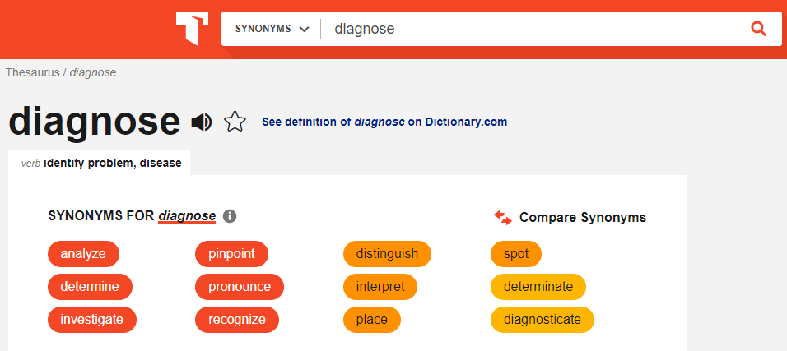
To Diagnose is to

Slide 4
Example Questions Across Industry
Field | Descriptive Analytics | Diagnostic Analytics | Predictive Analytics | Prescriptive Analytics
Healthcare | How many patients went to the hospital/clinic last week? | Why did these patients go to the hospital? | Which patient is likely to need hospitalization? | Extra home treatment to prevent visits
Life science | What are the total medicines available by pharmaceuticals? | Why do we not have more medicines or pharmaceuticals? | Which pharmaceutical is likely to monopolize the production of medicines? | Increase the number of pharmaceuticals and medicines
Finance | Where was the stock market in the last 6 months? | Why was the stock market that high/low? | What will the level be for the stock market in the next 6 months? | Reduce downside risk by diversifying a portfolio
Politics | Who was elected last? | Why were they elected? | Who will be elected next? | Increase voter education to reduce downside societal impact
Education | How many students are learning online? | Why are they taking courses online? | How many more courses are needed to support them? | Increase the number of courses
Non-profit | How are non-profits independent? | Why are they effective? | How many more non-profits can be created? | Decrease barriers to creating non-profits
Human rights | What is the number of refugees in the world? | Why are there so many refugees? | What are the likely future sources of refugees? | Reduce colonialism, imperialism, 'isms and let people live

Slide 5
Diagnostic Analysis
What is Diagnostic Analytics? Use both internal and external data sources to answer the question “Why”
Why did sales go Up or Down?
Season
Location
Hurricane
Social Media
Competition
Traffic
Parking
Product

Slide 6
Diagnostic Analysis
Actions in Diagnostic Analytics
Relationship Determination
Conclude / Recommend
Identification
Discovery
Identify the anomalies that cannot be fully explained by current understanding
Look into the data to look for previously- unknown patterns
Determine causal relationships between patterns that lead to the anomalies
Suggest changes based on your findings and see if other patterns appear

Slide 7
Diagnostic Analysis
Diagnostic Analytics helps with:
Identify factors and potential causes from historical data
Note relationships among data elements
Decide where to “dig deeper” as you look for potential causes
Answer questions posed by key stakeholders such as CEOs, CFOs, business strategists, and other high-level decision-makers in your organization

Slide 8
Techniques of Diagnostic Analysis
Box Plots
Outliers
Correlations

Slide 9
Minimum: Lowest value in the dataset (excluding outliers)
1st Quartile (Q1 or 25th percentile): Median value of the lower half of the dataset
Median (Q2 or 50th percentile): Middle value of the dataset
3rd Quartile (Q3 or 75th percentile): Median value of the upper half of the dataset
Maximum: Highest value in the dataset (excluding outliers)

Slide 10
Techniques of Diagnostic Analysis
Box Plots
Minimum: Lowest value in the dataset (excluding outliers)
1st Quartile (Q1 or 25th percentile): Median value of the lower half of the dataset
Median (Q2 or 50th percentile): Middle value of the dataset
3rd Quartile (Q3 or 75th percentile): Median value of the upper half of the dataset
Maximum: Highest value in the dataset (excluding outliers)

Slide 11
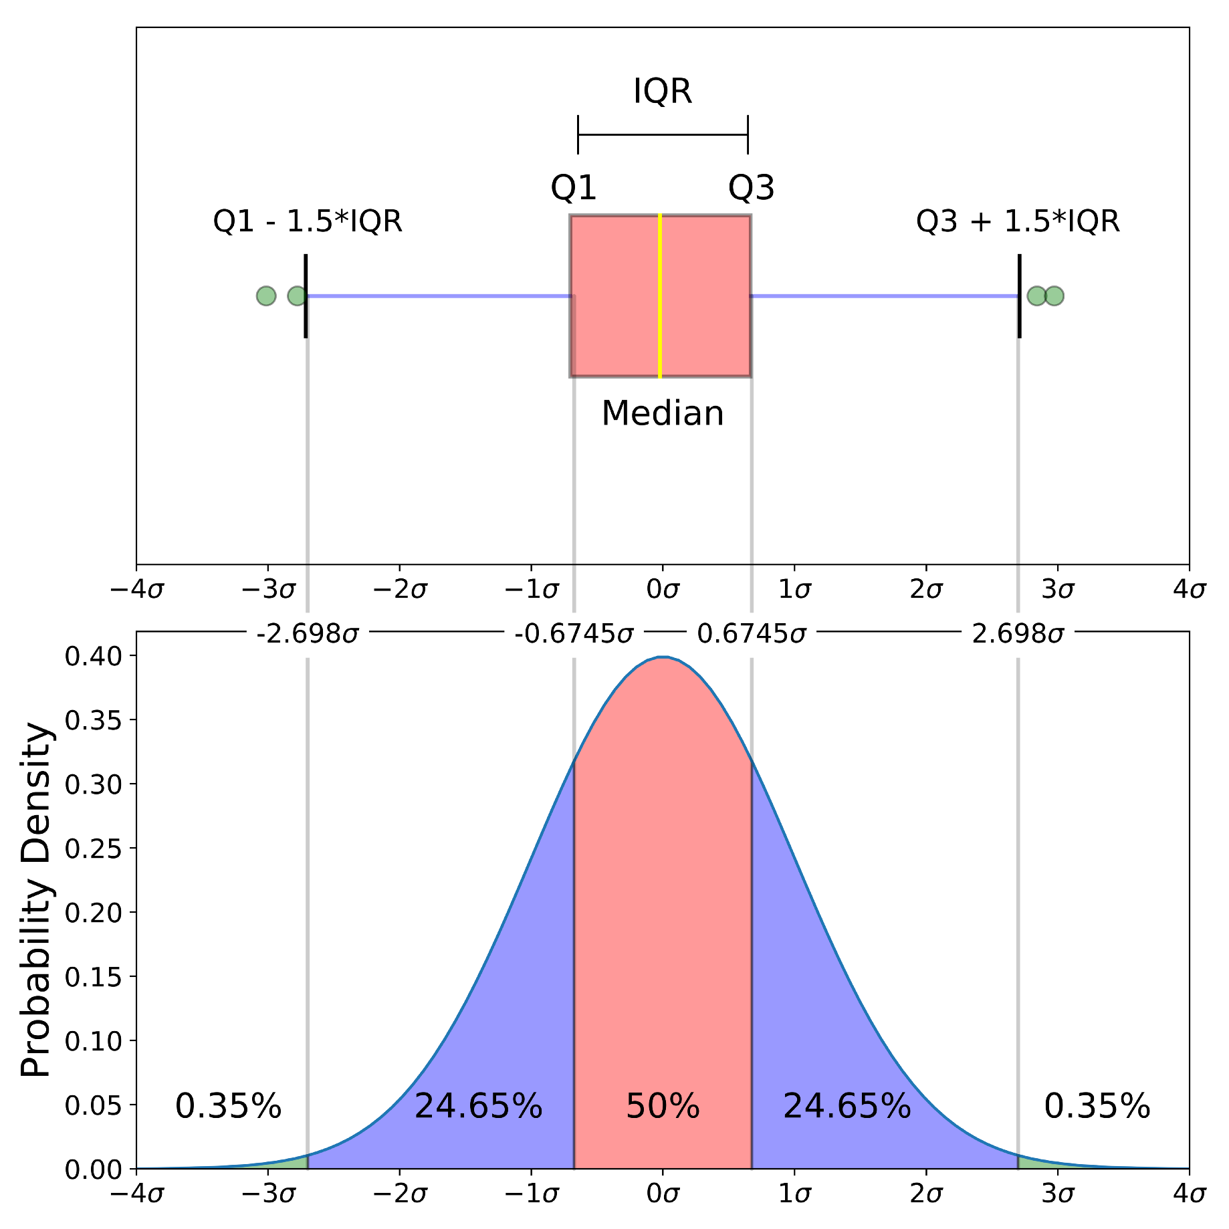
Techniques of Diagnostic Analysis
Box Plots

Slide 12
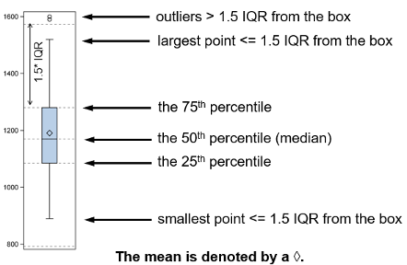
Box Plots

Slide 13
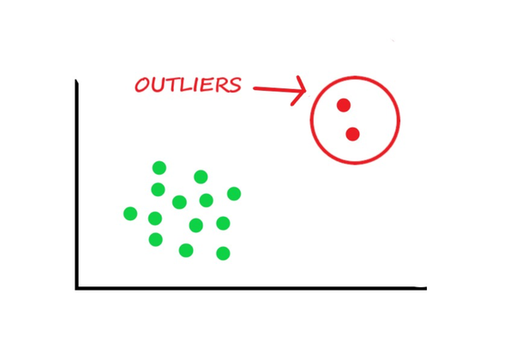

Techniques of Diagnostic Analysis
Outliers

Slide 14
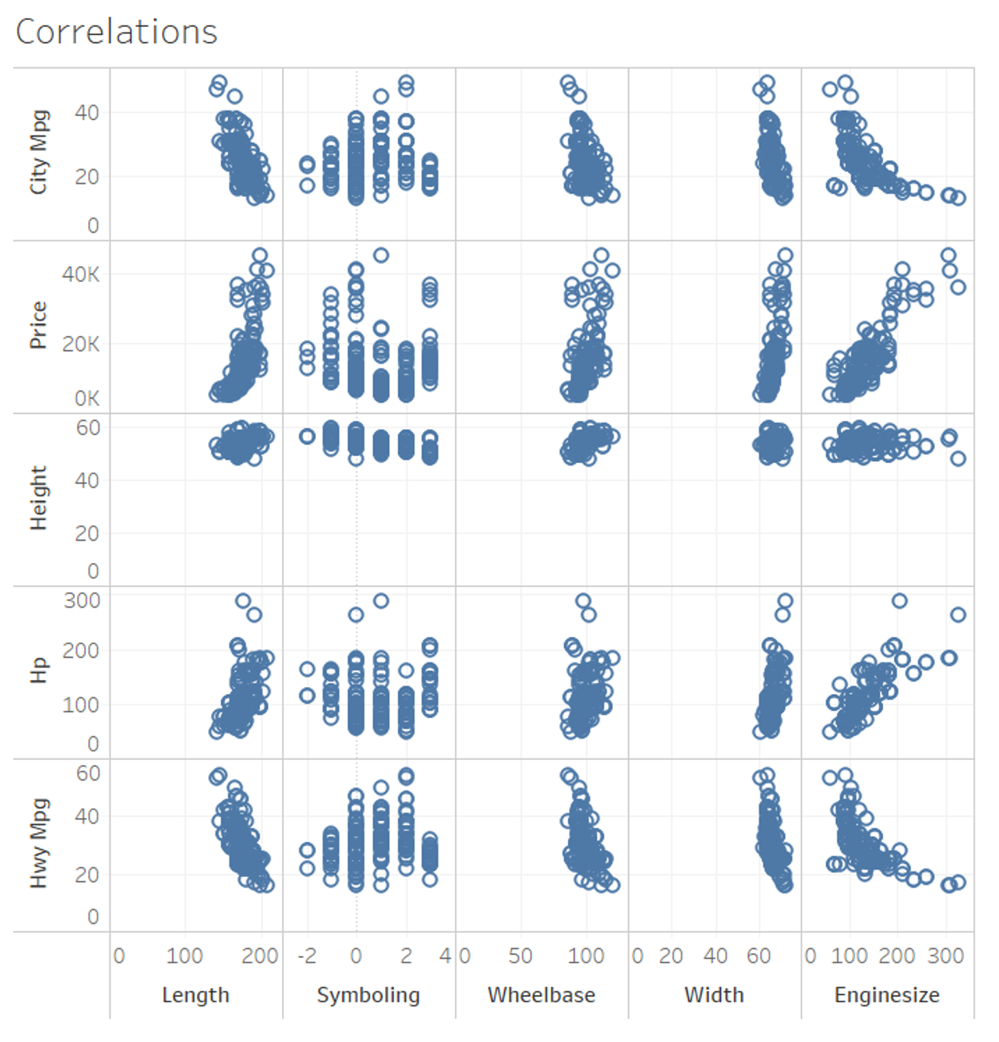
Techniques of Diagnostic Analysis
Correlations
Notes:
example from day 5 reading - refer to reading for clarification

Slide 15
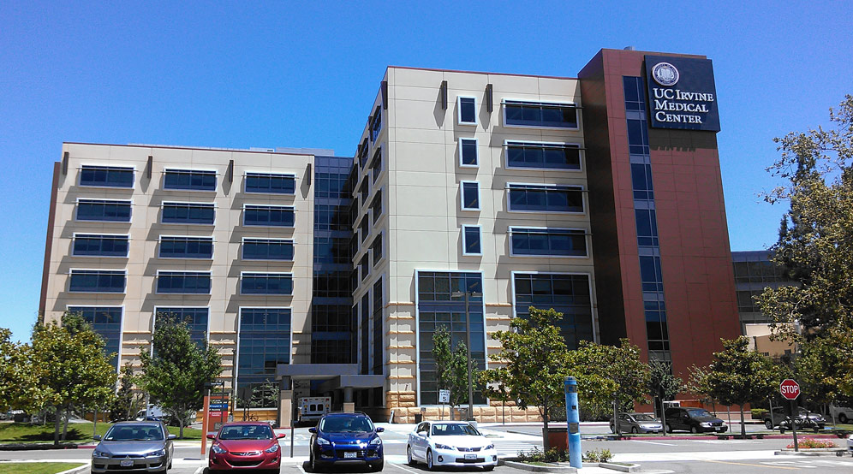
AVOIDING 30-DAY HOSPITAL READMISSIONS

Slide 16
AVOIDING 30-DAY HOSPITAL READMISSIONS
Hospitals and health systems are subject to significant penalties under Medicare’s Hospital Readmissions Reduction program (HRRP)
Financial incentive for preventing unplanned returns to the inpatient setting.
In addition to improving transitions of care and deploying care coordination strategies.
Hospitals would like to look at increased risk of readmission within the 30-day window.

Slide 17
AVOIDING 30-DAY HOSPITAL
Events occurring during a hospital stay:
Infection
Vital sign instability
Longer length of stay
Result in a significantly elevated chance of a 30-day readmission.

Slide 18

Q&A
What questions and comments do you have?

Slide 19



Application Case: An Analytics Approach to Student Retention Management
Notes:
SLIDES 15 - 23 are examples that can be used - if they are not used, delete slides

Slide 20
Student Attrition
What is attrition?
Rough figures
Freshmen student attrition rate: _20%_
Graduation rate (6 year): _55%_
Attrition rates (especially freshmen student attrition) change significantly amongst institutions
For some schools, it is less than 1%
For others it may be over 40%

Slide 21
Motivation
Retention is important because it affects…
Reputation of an institution (perception towards an institution)
Rankings of an institution
Funding potential of an institution
Better use of limited institutional resources
Improvement of education in general
Betterment of the community

Slide 22
Background Work
Vincent Tinto (Tinto, 1975)
Pioneer of the student retention studies
Developed the famous student integration model
Journals
Journal of Student Retention
Research in Higher Education
Journal of Higher Education
College Student Journal
Consultancy companies…

Slide 23
Previous Studies…
Most retention studies focus on a single variable (e.g., ethnicity, residency, high school GPA, gender, financial wellbeing, etc.)
Vast majority of them are survey based empirical and/or behavioral in nature
The goal has been to understand the general causality behind the phenomenon
Most retention management programs are based on the theories developed through these heterogeneous behavioral studies

Slide 24
An Analytics Approach
Data: a large multi-year data collected from a variety of databases
Year | Total Number of Freshmen Students | Returned for the 2nd Fall Semester | Freshmen Attrition (%)
2005 | 3306 | 2604 | 21.23
2006 | 3234 | 2576 | 20.35
2007 | 3207 | 2445 | 23.76
2008 | 3070 | 2459 | 19.90
2009 | 3144 | 2365 | 24.78
2010 | 3550 | 2813 | 20.76
2011 | 3894 | 3036 | 22.03
Total: | 23405 | 18298 | 21.82

Slide 25
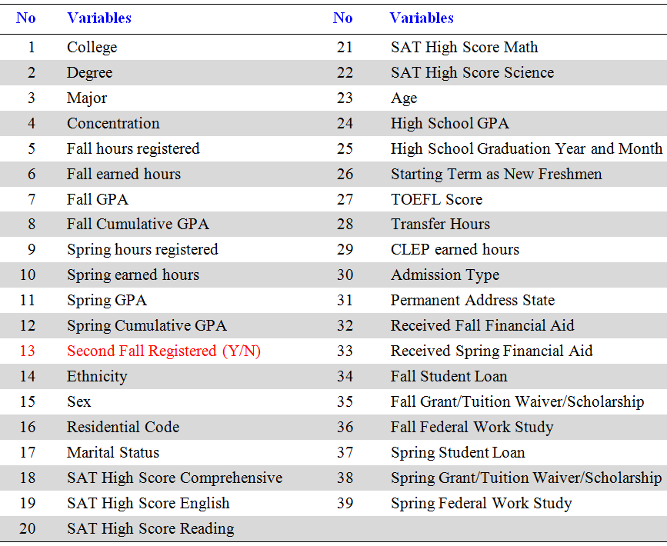
Data & Variables

Slide 26
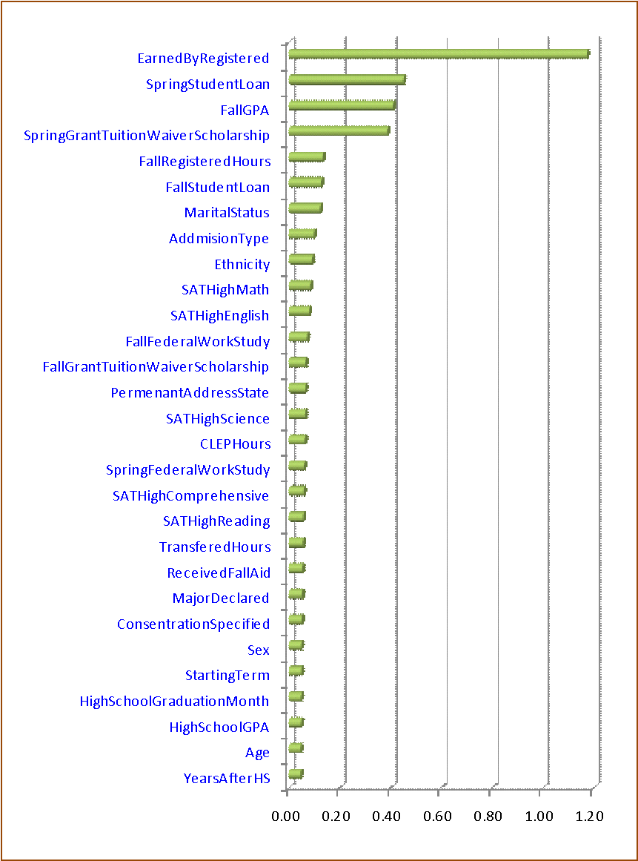
Important Variables
The results are based on aggregated sensitivity analysis of all 4 models

Slide 27
Demo:
Topics

